Slide 1
Bellalago Academy Mid-year state of the school
January 2024

Slide 2
Let’s Celebrate!
We are very happy to announce that Bellalago increased our school grade from a C to a B. We were two points away from an A. School recognition funds have been granted and plans for distribution will be shared today with the School Advisory Committee.
Bellalago’s Progress Monitoring (PM) 1 was compared to our mid-year PM 2 data and shows growth at every grade level.
Bellalago met or exceed the State and District averages in most areas. A mid-year state of the school was presented to staff on January 10, 2024, and with SAC on January 22, 2024. See attached presentation for details.

Slide 3
Reading Data

Slide 4
Math Data

Slide 5
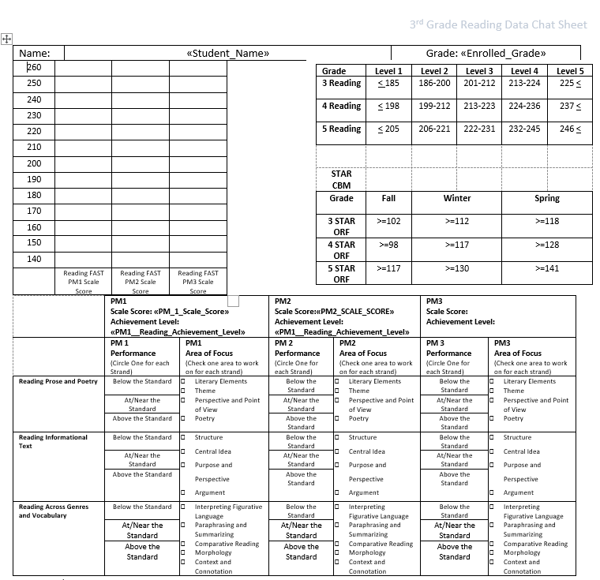
Student Data Chat
Student Data Chat forms
Forms will be pre-populated with student data.
Forms will be given during January PST Meetings

